Slide 1
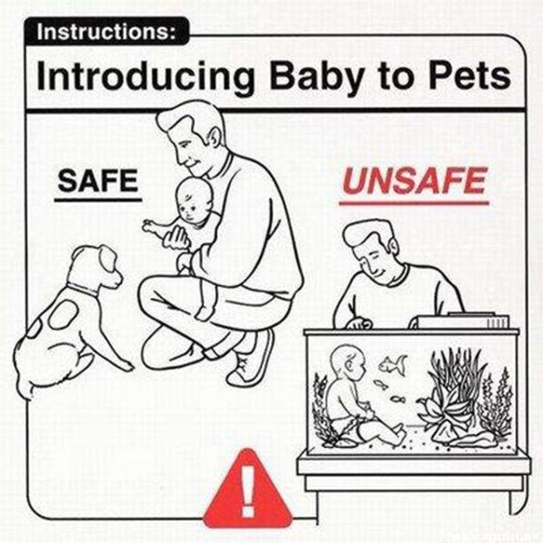
Follow the Safety
Arlo Belshee
http://arlobelshee.com/
@arlobelshee

Slide 2

What did she do?
Why was she the best?
Share in groups of 4, for 4 min total

Slide 3
The best boss ever?
Employee says
Manager says
“My boss is amazing. He leaves us alone to do the right thing. He doesn’t interfere, he just stays out of the way. We don’t even know he is there. Best boss I’ve ever had.”
“My job is to protect my team from the organization. The workers know what to do far better than I. I just need to keep the rest of the company from messing with them.”
This is a broken system!

Slide 4
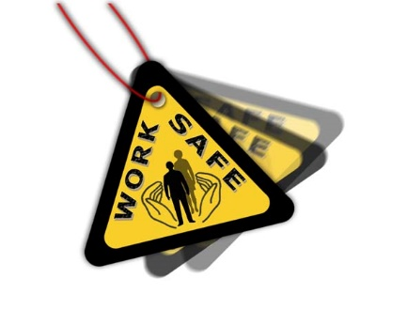
Gather data: Work Environment Checklist
Fill out the checklist in your groups
You have 8 minutes

Slide 5
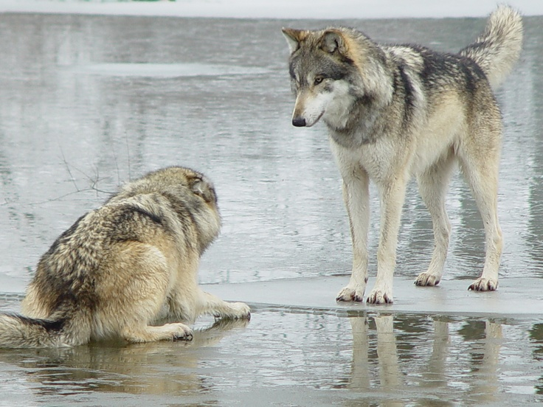
Modern business: systematic dominance and coerced consent

Slide 6
Hierarchical structure – 2 roles
Manager
Worker (IC)
Makes decisions (product, personnel, financial, and process)
Is supposed to see wider context
Indirect interaction with all stakeholders
Provides vision, constraints
Decides which problems reports are allowed to solve
Removes obstacles
Does work
Is supposed to see details
Direct interaction with some key stakeholders
Maps vision, constraints to actual work
Solves problems
Raises concerns

Slide 7
System root 1: rugged individualism myth
That there is a difference between the average and the first class man is known to all employers, but that the first class man can do in most cases from two to four times as much is known to few, and is fully realized only by those who have made a thorough and scientific study of the possibilities of men.
Fredrick Winslow Taylor, Shop Management, p. 9
All rational action is in the first place individual action. Only the individual thinks. Only the individual reasons. Only the individual acts.
Ludwig von Mises, Socialism: An Economic and Sociological Analysis

Slide 8
System root 2: covering for incompetence
Now one of the very first requirements for a man who is fit to handle pig iron as a regular occupation is that he shall be so stupid and so phlegmatic that he more nearly resembles in his mental make-up the ox than any other type. The man who is mentally alert and intelligent is for this very reason entirely unsuited to what would, for him, be the grinding monotony of work of this character. Therefore the workman who is best suited to handling pig iron is unable to understand the real science of doing this class of work.
Fredrick Winslow Taylor, Principles of Scientific Management, p. 59
It is only through enforced standardization of methods, enforced adoption of the best implements and working conditions, and enforced cooperation that this faster work can be assured. And the duty of enforcing the adoption of standards and enforcing this cooperation rests with management alone.
Fredrick Winslow Taylor, Principles of Scientific Management, p. 64

Slide 9
Taylorist hierarchical structure – 2 roles
Manager
Worker (IC)
Responsible for:
Make decisions that impact others
Choose / grow others – paternalistic
Working with other managers to attain consistency
Judged on:
Outcomes of decisions
Morale of employees
Growth of employees
Responsible for:
Doing work to plan
Deep knowledge in a specialty
Providing info summaries to managers
Judged on:
Stakeholder satisfaction with work
Cooperation with other workers
Work quantity as compared to other workers

Slide 10
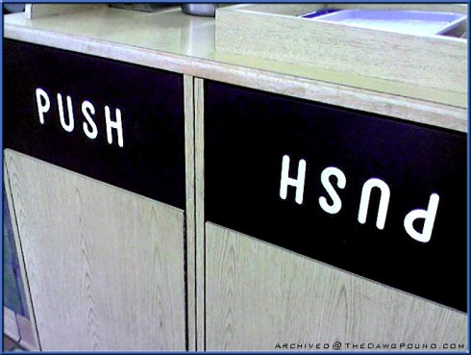
Is your business best based on cut-throat individualism and covering for incompetence?

Slide 11
System: the hierarchy
Relationships (inbound)
Managers:
Boss manager
Peer manager
Peer worker
Reporting manager
Reporting worker
Workers
Boss manager
Peer manager
Peer worker
Manager
Manager
Manager
Manager
Worker
Worker
Worker
Worker
Worker
Worker
Worker
Worker
Worker
Manager
Worker
Worker

Slide 12
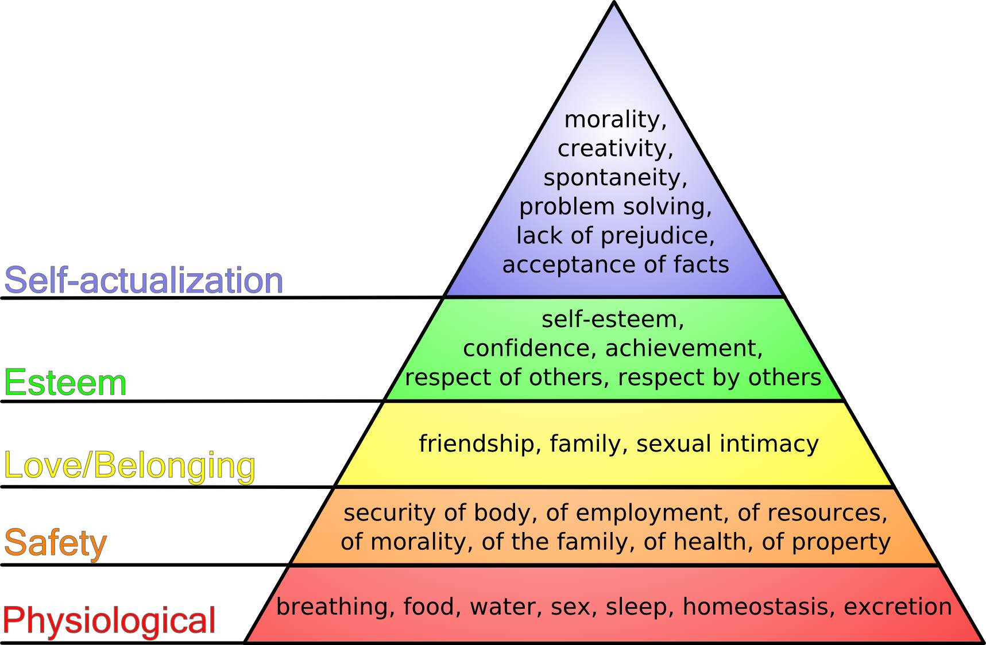

Slide 13
Meta-pattern: safety is the root
Your actions can create either safety or unsafety for me
If you give me safety, I will try to use that to get things done and improve myself
If you give me unsafety, I will try to fix our relationship

Slide 14
Meta-pattern: hierarchy constrains communications
Separation in the hierarchy introduces a (political) cost and delay in communications
If we are adjacent I can just talk to you, daily
If we are one step removed, I talk with you once a week
If we are two steps removed, I talk with you rarely and tend to use proxies

Slide 15
Meta-pattern: hierarchy partially matches work breakdown
Hierarchy clusters teams by product. The people I need to talk with most are closest to me. Except…
…in functional orgs
…customer needs change faster than reporting structures
…number of people needed per product changes rapidly
If you and I are distant in the hierarchy, we may or may not have independent work

Slide 16
Pattern 1: Micromanagement
Threats:
Livelihood / status depends on boss happiness:
Outcomes
Easy to manage (infrequent goal changes)
Available actions:
Issue commands down
Make decisions
Request info from below
Provide / color info to above
Grant status and rewards
Manager
Actions taken:
Demand frequent status updates
Demand predictability / follow the plan
Issue commands
Reward compliant heroes
Annoying facts:
Outcome is 95% execution
Success is responsive
Your guess is wrong
Actions taken:
Hide failures
Hide variance from plan
Do what customer wants
Think boss is idiot
Worker

Slide 17
Unsafety meta-pattern
Obvious to person 1
Initiating Threat
Person 1
Response Action
Sustaining Threat
Obvious to person 2
Resulting Threat
Resulting Action
Person 2

Slide 18
Pattern 1: Micromanagement – full system
Manager
Actions taken:
Encourage experimentation
Define scope of safe risk
Facilitate conversations rather than deciding
Reward collaborators
Actions taken:
Provide real-world data
Provide new options
Provide sales pitch for up the chain
Worker

Slide 19
Pattern 2: Frozen middle

Slide 20
Pattern 3: Abusive rock-star worker

Slide 21
Other explainable patterns
Peter Principle
Scapegoating
“People fear change”
Process flavor of the month
Cronyism
Coerced consent
Having architecture
Highest Paid Person’s Opinion (HiPPO)

Slide 22
Alternatives that aren’t
A different hierarchy:
Functional
Product-focused
Customer-focused
Matrix
No structure / Valve
Rotational “teams”
Holocracy

Slide 23
Alternative structure 1: Sociocracy

Slide 24
Alternative structure 2: pair management too

Slide 25
Alternative structure 3: tight teams + work out loud

Slide 26
Follow the Safety
Arlo Belshee
http://arlobelshee.com/
@arlobelshee

Slide 27
Behavioral Influencers
Expectations
Tools / Processes
Visible Results
External
Managers
Peers
Direct Reports
Shareholders
Internal
Perception of normal
External
Internal
External
Internal
Skills / Knowledge
Capability
Motivation
External
Internal

